Slide 1
Senate Commerce Committee Hearing
April 10, 2017
Carl G. Hedde, CPCU Head of Risk Accumulation
April 10, 2017

Slide 2
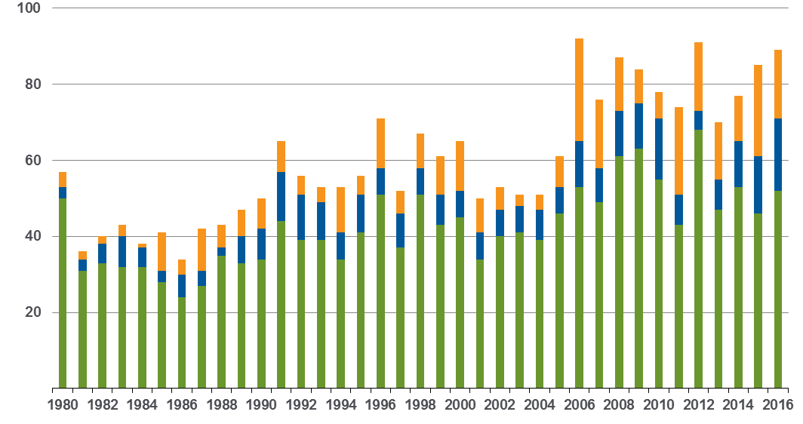
Weather-related loss events in the U.S. 1980 – 2016
Number of relevant events by peril
Number
Meteorological events
(Tropical storm, extratropical storm, convective storm,
local storm)
Hydrological events
(Flood, mass movement)
Climatological events
(Extreme temperature,
drought, forest fire)
Accounted events have caused at least one fatality and/or produced normalized losses ≥ US$ 100k, 300k, 1m, or 3m (depending on the assigned World Bank income group of the affected country).

Slide 3
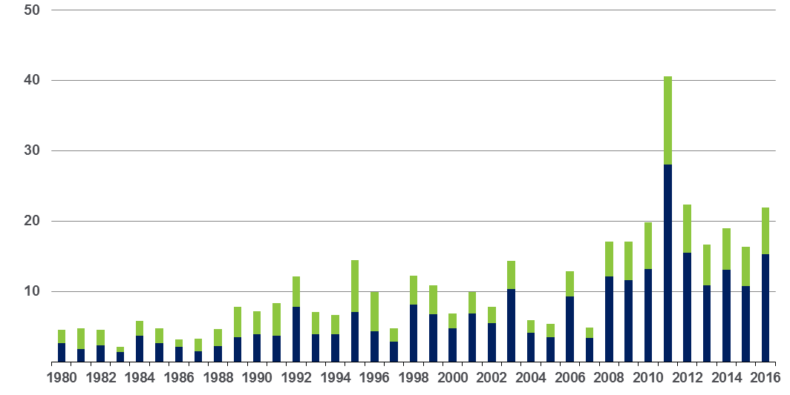
Convective storm events* in the U.S. 1980 – 2016
Overall and insured losses
US$ bn
Overall losses
(in 2016 values)
Insured losses
(in 2016 values)
Inflation adjusted via country-specific consumer price index.
*(incl. severe storm, hail, tornado,
lightning, flash flood)

Slide 4
Natural disaster losses in the U.S. 2016
US Natural Catastrophe Update
As of January 4, 2017 | Number of Events | Fatalities | Estimated Overall Losses (US $m) | Estimated Insured Losses (US $m)*
Severe Thunderstorm | 43 | 40 | 19,000 | 14,000
Winter Storms & Cold Waves | 7 | 55 | 1,700 | 1,000
Flood, Flash Flood | 19 | 83 | 15,000 | 4,300
Earthquake & Geophysical | 2 | - | Minor losses | Minor losses
Tropical Cyclone | 2 | 52 | 7,000 | 3,500
Wildfire, Heat Waves, & Drought (ongoing drought condition without loss estimation for the half year) | 18 | 32 | 1,200 | 1,000
Totals | 91 | 262 | 43,900 | 23,800
*Source: Property Claim Services (PCS)

Slide 5
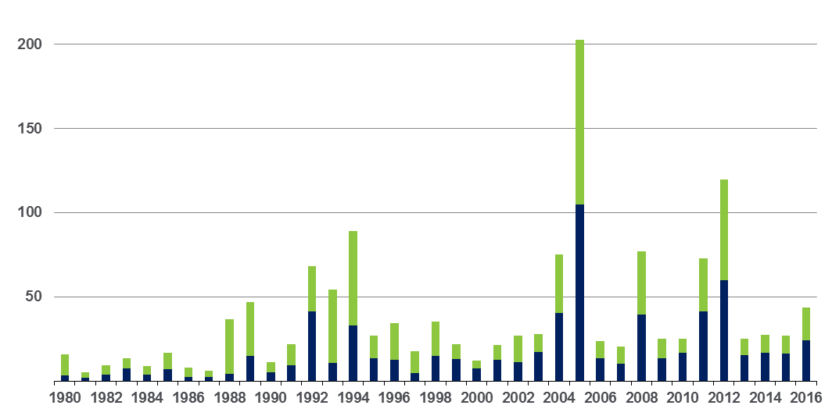
Loss events in the U.S. 1980 – 2016
Overall and insured losses
US$ bn
Overall losses
(in 2015 values)
Insured losses
(in 2015 values)
Inflation adjusted via country-specific consumer price index and consideration of exchange rate fluctuations between local currency and US$.

