Slide 1
The impact of smartphones, social media, and school laptops on youth mental health and academic performance
Jean M. Twenge
Professor of Psychology
San Diego State University
Website: www.jeantwenge.com
Twitter/X: @jean_twenge
Substack: Generation Tech

Slide 2
Started to notice sudden changes around 2012 …

Slide 3
Feeling left out and lonely: U.S. teens

Slide 4
Depressive symptoms, U.S. teens

Slide 5
Major depressive episode in the last year, U.S.
Department of Health & Human Services screening study

Slide 6
ER visits for self-harm, U.S. girls
Centers for Disease Control

Slide 7
Suicide rate, U.S. adolescents
Centers for Disease Control

Slide 8
What happened?

Slide 9
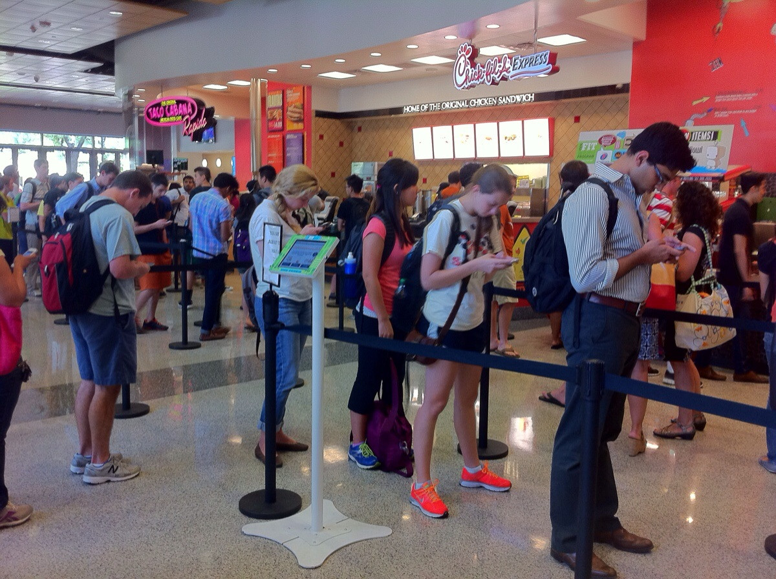

Slide 10
Time socializing in person
American Time Use Survey

Slide 11
Sleeping less than 7 hours a night

Slide 12
Social media and depression, UK 14-year-olds
Hours per day using social media
Notes:
The next question is: Are teens who spend a lot of time on devices thriving, or are they struggling? Teens say they are struggling. They sleep less – which is linked to both physical and mental health issues --, they are 71% more likely to have risk factors for suicide like depression, thinking about suicide, or having attempted suicide, and they are twice as likely to be unhappy. These are not small effects. And think about it: How happy are you when you’re on your phone, especially for a long time?

Slide 13
Families cutting back on screen time experiment
Denmark
Families restricted kids and teens’ leisure screen use to 3 hrs/wk
Handed over smartphones
  Replaced with flip phones
vs. control group
Can show causation
Results for kids & teens:
Schmidt-Persson et al. (2024)

Slide 14
Also:

Slide 15
NAEP academic performance, reading, U.S. 12th graders

Slide 16
NAEP academic performance, math, U.S. 12th graders

Slide 17
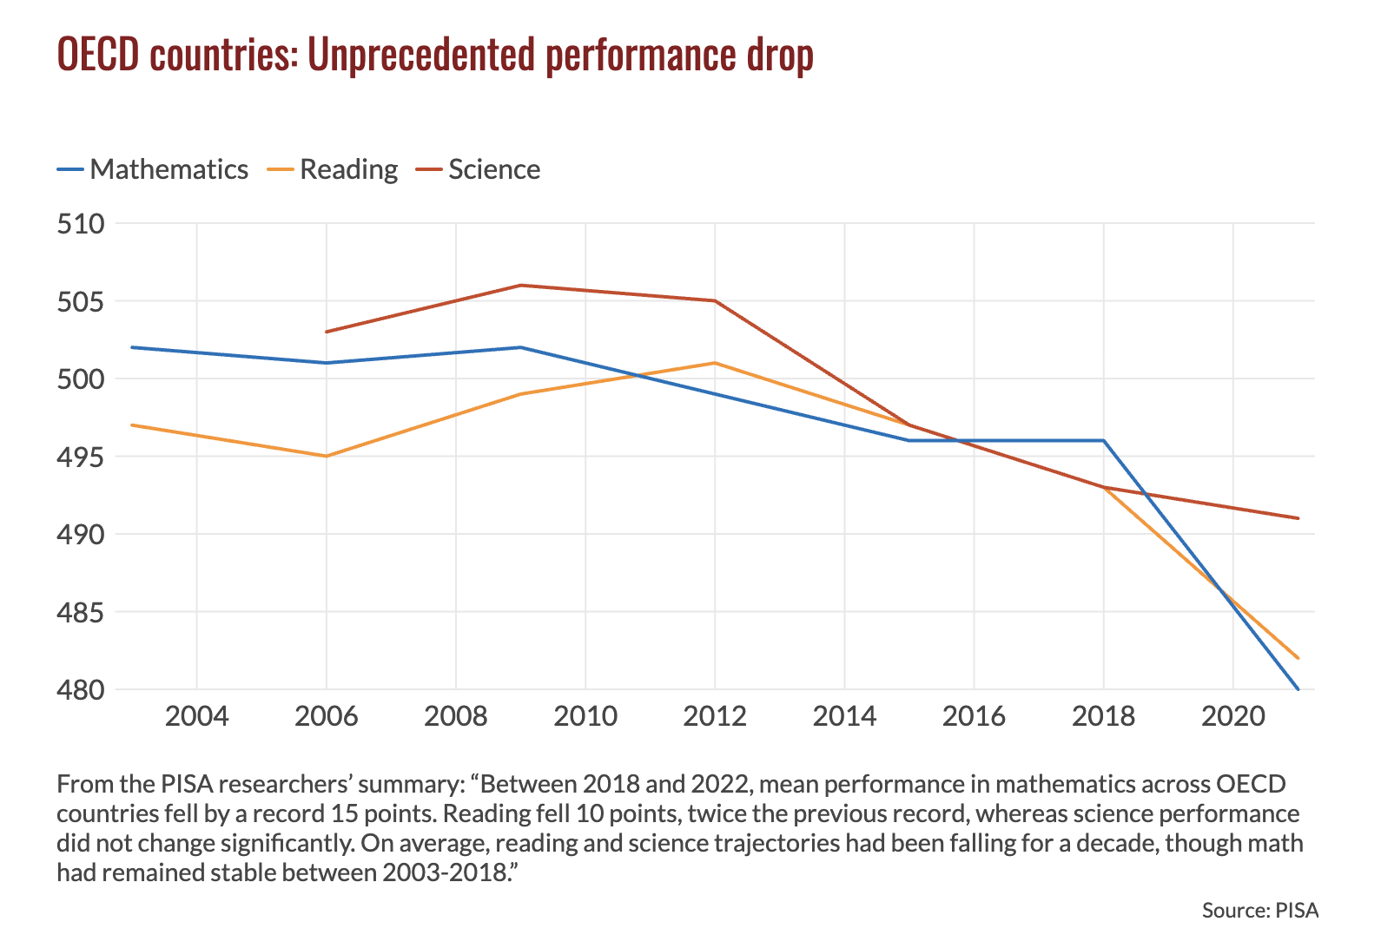

Slide 18
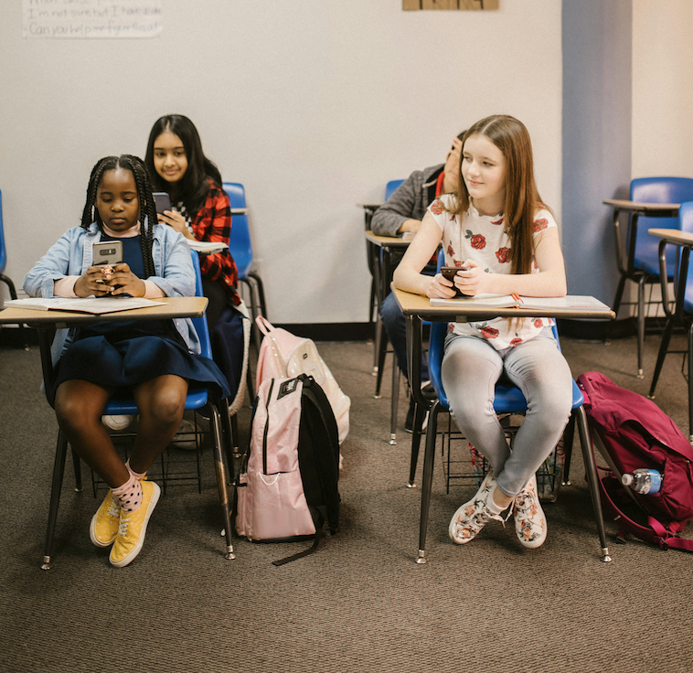
Why the decline?
One reason: Use of phones, tablets, and laptops for leisure during the school day
High school students use their phones for an hour during the school day
  Social media, videos, and games
  Not for educational purposes

Slide 19
Trends in h.s. science scores by leisure use of devices during school day

Slide 20
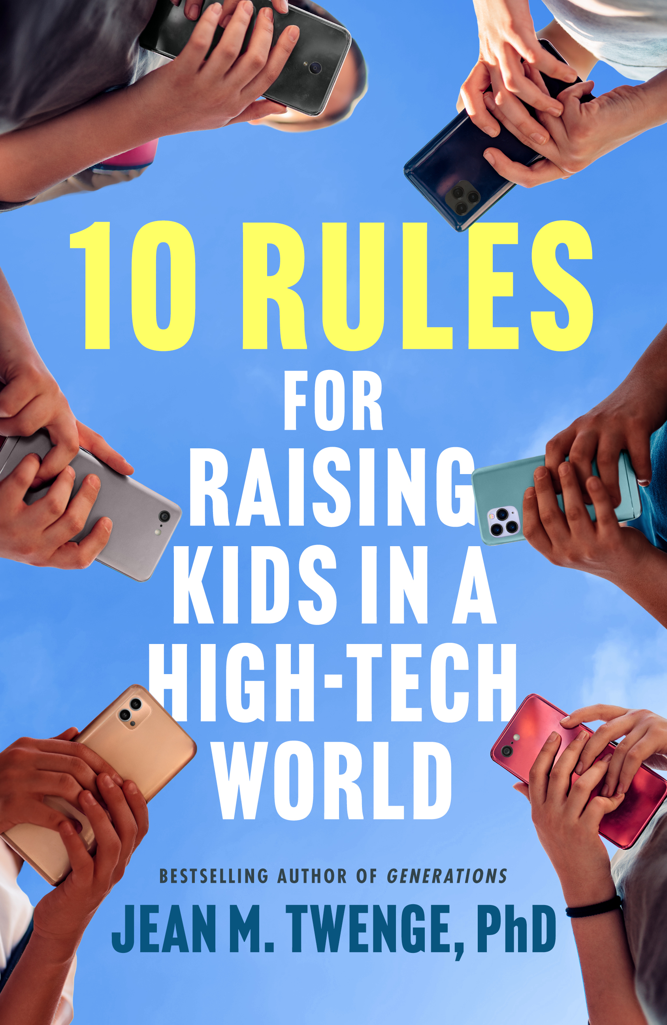
Thanks for listening!
Any questions?
Website: www.jeantwenge.com
Twitter/X: @jean_twenge
Substack: Generation Tech

